Slide 1
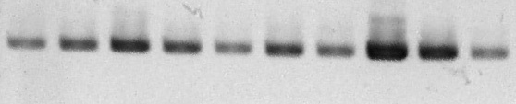

Figure 7B.
SA
Salt
MeJA
Wound
Control
SA
Salt
MeJA
Wound
Control
24hrs
72hrs
Os04g27430
Actin

